Slide 1
SpaceX Falcon 9 Landing Prediction
Applied data collection, SQL analysis, interactive visualization, and classification modeling
GitHub repository: https://github.com/cooper-710/Coursera-Capstone
Final Project Report | PDF Submission

Slide 2
IBM Data Science Capstone | SpaceX Falcon 9 Landing Prediction
Executive Summary
This project predicts Falcon 9 first-stage landing success using launch records, launch site data, payload mass, orbit, booster information, and engineered classification features.
The workflow covered API collection, web scraping, wrangling, SQL analysis, exploratory visualization, Folium mapping, a Plotly Dash dashboard, and machine learning classification.
EDA showed landing success improved over time and varied by launch site, orbit type, payload range, and booster version.
Four classification models were tested. Logistic Regression, SVM, Decision Tree, and KNN all reached about 83.3% test accuracy on the held-out test set.
The final model predicted successful landings well, but it was weaker at identifying failed landings.
Primary takeaway: SpaceX landing outcomes are strongly tied to launch maturity, launch context, and vehicle configuration, but failure prediction remains the harder task.
Cooper Robinson | GitHub: https://github.com/cooper-710/Coursera-Capstone

Slide 3
IBM Data Science Capstone | SpaceX Falcon 9 Landing Prediction
Introduction: Business Problem
SpaceX reduces launch cost by recovering and reusing the Falcon 9 first stage. Predicting whether the first stage will land successfully helps estimate launch economics, operational risk, and mission planning confidence.
1
Business question
2
Data science goal
3
Decision value
Can launch data predict whether Falcon 9 first stage recovery will succeed?
Build a complete workflow from raw data collection to predictive classification.
Identify launch patterns that increase or reduce landing success likelihood.
Target variable: Class, where 1 indicates landing success and 0 indicates unsuccessful or no landing.
Core features: payload mass, orbit, launch site, flight number, booster version, reuse indicators, and launch hardware variables.
Final deliverable: PDF report plus GitHub repository containing notebooks, dashboard app, and screenshots.
Cooper Robinson | GitHub: https://github.com/cooper-710/Coursera-Capstone

Slide 4
IBM Data Science Capstone | SpaceX Falcon 9 Landing Prediction
Project Workflow
1
Collect
2
Wrangle
3
Explore
SpaceX API and web scraping
Clean, filter Falcon 9, build Class label
EDA charts and SQL summaries
4
Visualize
5
Model
6
Report
Folium maps and Dash dashboard
Classification with tuned ML models
GitHub, PowerPoint, and PDF submission
The project was built as a technical report, not just a high-level executive summary. Each section includes method, result, and interpretation.
Cooper Robinson | GitHub: https://github.com/cooper-710/Coursera-Capstone

Slide 5
IBM Data Science Capstone | SpaceX Falcon 9 Landing Prediction
GitHub Repository
Repository link
https://github.com/cooper-710/Coursera-Capstone
Folder / File | Purpose
notebooks/ | All completed Jupyter notebooks for data collection, wrangling, EDA, SQL, maps, and machine learning
dashboard/ | Plotly Dash application file
images/ | Screenshots and chart outputs used in the final report
README.md | Project overview, methods, questions, and repository structure
requirements.txt | Python packages needed to rerun the analysis
The GitHub repository is included in the PDF report to satisfy the project deliverable requirement.
Cooper Robinson | GitHub: https://github.com/cooper-710/Coursera-Capstone

Slide 6
IBM Data Science Capstone | SpaceX Falcon 9 Landing Prediction
Data Collection Methodology
1
SpaceX API
2
Web scraping
Collected structured launch details including payloads, launch sites, booster data, landing outcomes, dates, and mission metadata.
Scraped Falcon 9 launch records from a historical launch table to supplement API data and practice HTML table extraction.
API notebook output included normalized launch data and saved the cleaned records for downstream tasks.
Web scraping notebook parsed HTML tables, cleaned inconsistent text, and exported a structured CSV.
The combined workflow created a reproducible data source for wrangling, SQL, EDA, dashboarding, and prediction.
Notebook | Main deliverable
jupyter-labs-spacex-data-collection-api.ipynb | API dataset from SpaceX launch records
jupyter-labs-webscraping.ipynb | Scraped Falcon 9 launch table
Cooper Robinson | GitHub: https://github.com/cooper-710/Coursera-Capstone

Slide 7
IBM Data Science Capstone | SpaceX Falcon 9 Landing Prediction
Data Wrangling and Feature Engineering
Filtered the dataset to Falcon 9 records only, excluding Falcon 1.
Handled missing payload mass values by using the calculated mean payload mass.
Converted raw landing outcomes into a binary Class target for machine learning.
Created features for launch site, orbit, payload mass, flight count, grid fins, reused hardware, legs, landing pad, and booster block.
Exported cleaned data for later EDA, dashboard, and modeling notebooks.
Wrangling output | Value
Target field | Class
Success label | 1 = landed
Failure label | 0 = did not land
Common launch sites | CCAFS SLC 40, KSC LC 39A, VAFB SLC 4E
High-count orbits | GTO, ISS, VLEO, PO
This step changed the project from raw historical launch records into a usable supervised classification dataset.
Cooper Robinson | GitHub: https://github.com/cooper-710/Coursera-Capstone

Slide 8
IBM Data Science Capstone | SpaceX Falcon 9 Landing Prediction
EDA and Visual Analytics Methodology
Used pandas, seaborn, and matplotlib to compare landing outcome patterns across payload mass, flight number, launch site, orbit type, and year.
Used SQL to answer structured questions from the launch table, including site lists, payload summaries, outcome counts, and date-filtered records.
Used Folium for spatial analysis of launch sites and nearby geography.
Used Plotly Dash for an interactive dashboard with dropdown, slider, pie chart, and scatter plot callbacks.
1
Static EDA
2
SQL EDA
3
Interactive visual analytics
Scatter, bar, and line charts
Relational queries and grouped summaries
Maps and dashboard filters
The analysis focused on both interpretability and repeatability, with each method producing outputs for the final report.
Cooper Robinson | GitHub: https://github.com/cooper-710/Coursera-Capstone

Slide 9
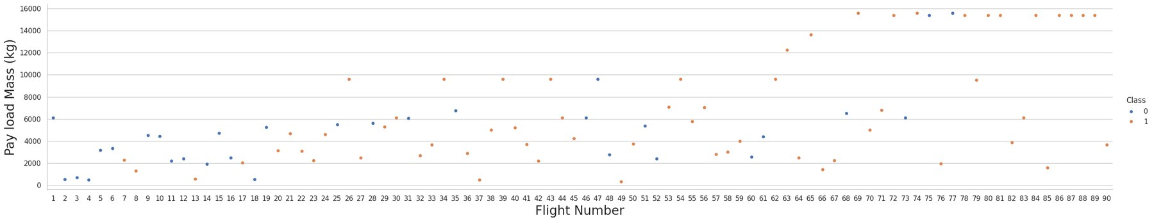
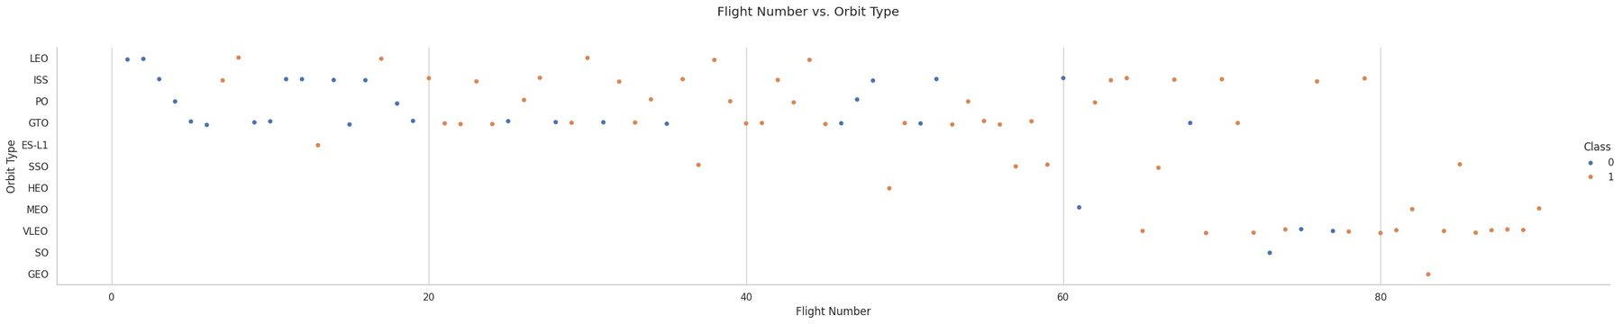
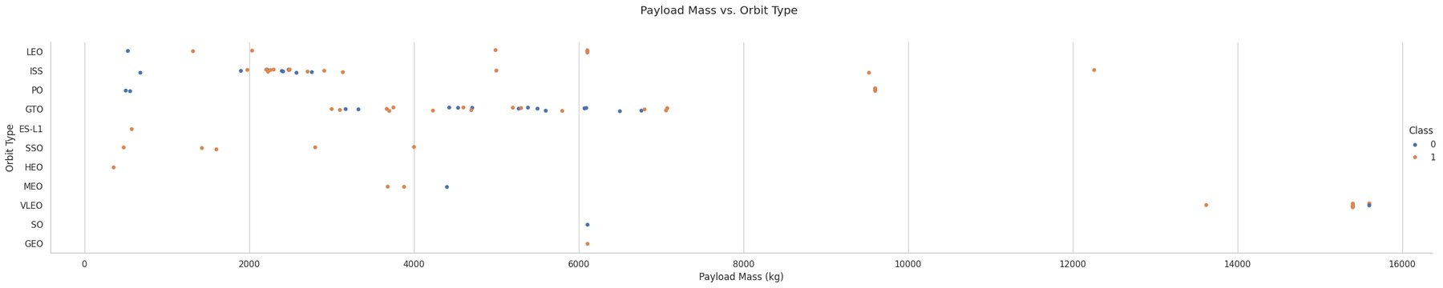
IBM Data Science Capstone | SpaceX Falcon 9 Landing Prediction
EDA Results: Flight Number and Payload Mass
Later flights show a higher concentration of successful outcomes.
Payload mass alone does not fully explain landing success, but it interacts with launch site, orbit, and booster maturity.
Flight number is a useful proxy for operational learning and program maturity.
Cooper Robinson | GitHub: https://github.com/cooper-710/Coursera-Capstone

Slide 10
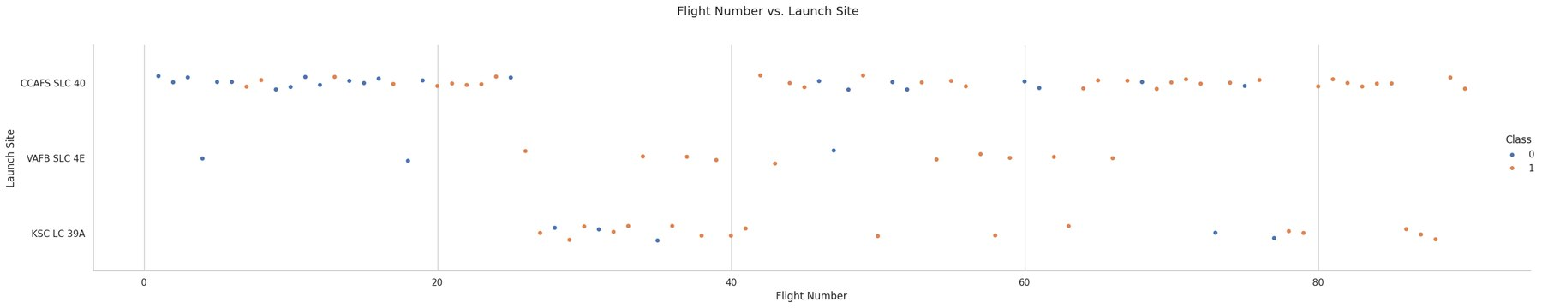
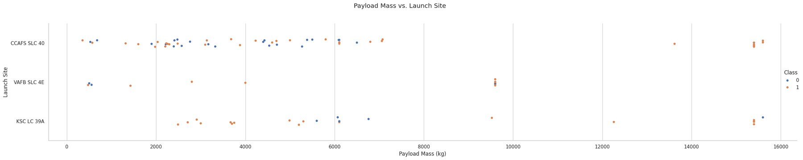
IBM Data Science Capstone | SpaceX Falcon 9 Landing Prediction
EDA Results: Launch Site Patterns
Launch sites show different success patterns because they support different mission profiles, payload ranges, and orbital requirements.
Cooper Robinson | GitHub: https://github.com/cooper-710/Coursera-Capstone

Slide 11
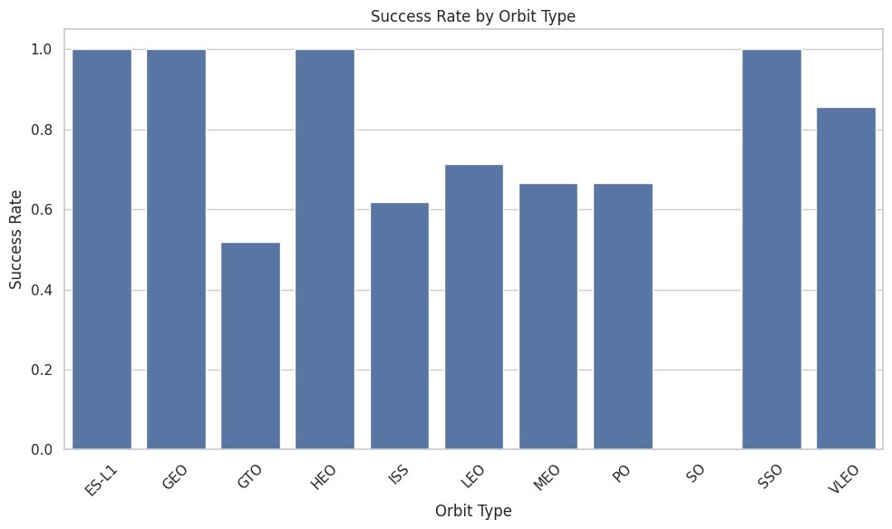
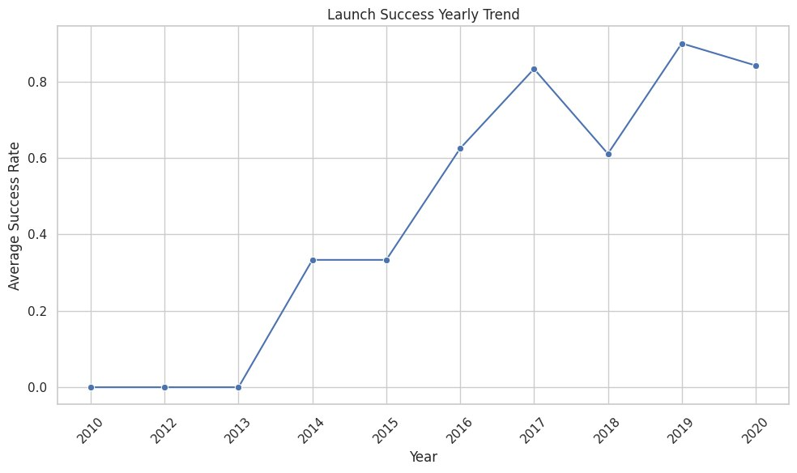
IBM Data Science Capstone | SpaceX Falcon 9 Landing Prediction
EDA Results: Orbit Type and Yearly Trend
Some orbit types had noticeably higher success rates than others.
Average yearly success rate rose sharply after the early Falcon 9 years.
The trend supports the idea that reuse and recovery capability improved as SpaceX gained launch experience.
Cooper Robinson | GitHub: https://github.com/cooper-710/Coursera-Capstone

Slide 12
IBM Data Science Capstone | SpaceX Falcon 9 Landing Prediction
SQL Methodology
Loaded the cleaned SpaceX CSV into a SQLite database.
Created a working launch table with non-null dates.
Used SQL to summarize payload mass, launch sites, booster versions, landing outcomes, and date-specific records.
SQL results were used to validate the exploratory analysis and provide reproducible tabular findings.
SQL task category | Example query result
Launch site list | Four distinct launch sites found
Payload aggregation | NASA CRS payload total = 45,596 kg
Booster filtering | Average payload for F9 v1.1 = 2,928.4 kg
Date filtering | First successful ground pad landing = 2015-12-22
Outcome grouping | Mission outcomes and landing outcomes counted by category
Cooper Robinson | GitHub: https://github.com/cooper-710/Coursera-Capstone

Slide 13
IBM Data Science Capstone | SpaceX Falcon 9 Landing Prediction
SQL Results: Core Summary Queries
Question | SQL result
Distinct launch sites | CCAFS LC-40, VAFB SLC-4E, KSC LC-39A, CCAFS SLC-40
Total payload mass for NASA CRS | 45,596 kg
Average payload mass for F9 v1.1 | 2,928.4 kg
First successful ground pad landing | 2015-12-22
The SQL results confirm that the dataset includes multiple launch facilities and mission profiles.
Payload mass summaries give context for mission scale and customer-specific launch activity.
The first ground pad recovery date provides a clear milestone in the recovery timeline.
SQL adds structure and auditability. The same questions can be rerun directly against the cleaned launch table.
Cooper Robinson | GitHub: https://github.com/cooper-710/Coursera-Capstone

Slide 14
IBM Data Science Capstone | SpaceX Falcon 9 Landing Prediction
SQL Results: Landing Outcome Patterns
Landing outcome between 2010-06-04 and 2017-03-20 | Count
No attempt | 10
Success (drone ship) | 5
Failure (drone ship) | 5
Success (ground pad) | 3
Controlled (ocean) | 3
Uncontrolled (ocean) | 2
Failure (parachute) | 2
Precluded (drone ship) | 1
Payload query | Result
Max payload mass | 15,600 kg
Boosters carrying max payload | F9 B5 B1048.4, B1049.4, B1051.6, B1060.3, B1049.7
Successful drone ship payload filter | Returned successful drone ship landings between 4,000 and 6,000 kg
Outcome counts show that early launch years included a substantial number of no-attempt or failed recovery outcomes.
Later booster versions carried larger payload masses, which aligns with the broader technology maturity pattern.
Cooper Robinson | GitHub: https://github.com/cooper-710/Coursera-Capstone

Slide 15
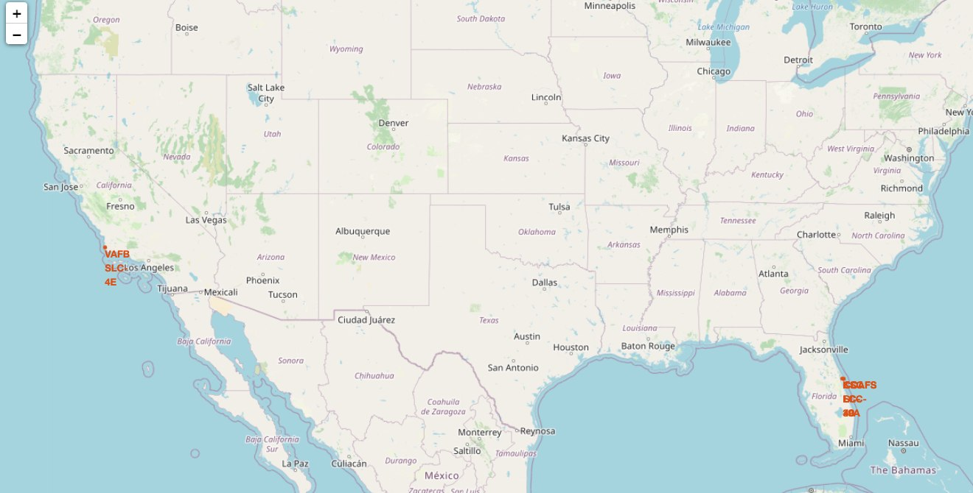
IBM Data Science Capstone | SpaceX Falcon 9 Landing Prediction
Interactive Map Methodology Using Folium
Mapped all launch site coordinates using Folium.
Added colored launch outcome markers to compare successful and unsuccessful outcomes by location.
Used marker clustering to make high-density launch records easier to interpret.
Added proximity analysis to examine geographic context near coastlines, cities, railways, and highways.
Map-based analysis makes launch geography visible, which is hard to communicate from tables alone.
Cooper Robinson | GitHub: https://github.com/cooper-710/Coursera-Capstone

Slide 16
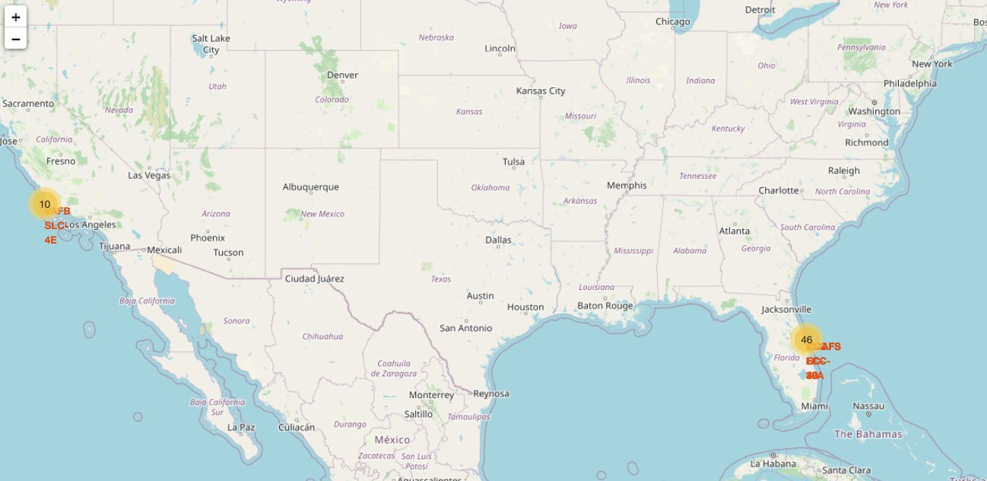
IBM Data Science Capstone | SpaceX Falcon 9 Landing Prediction
Folium Results: Launch Site Geography
Launch sites are located near coastlines, reducing risk by routing launches over water.
Clustering makes repeated launches at the same site easier to review.
Geospatial results support the launch-site section of the dashboard and final insights.
Cooper Robinson | GitHub: https://github.com/cooper-710/Coursera-Capstone

Slide 17
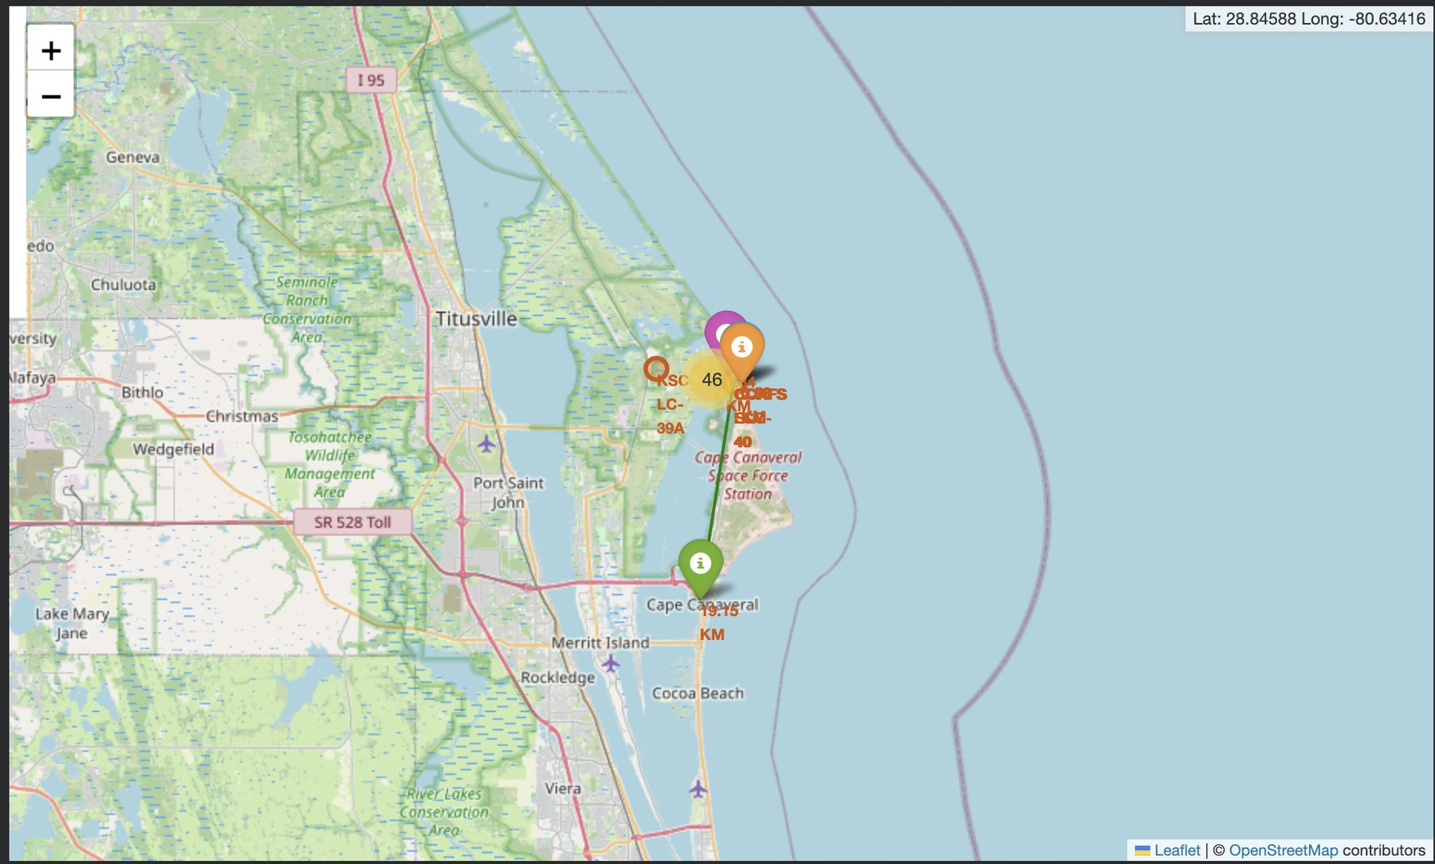
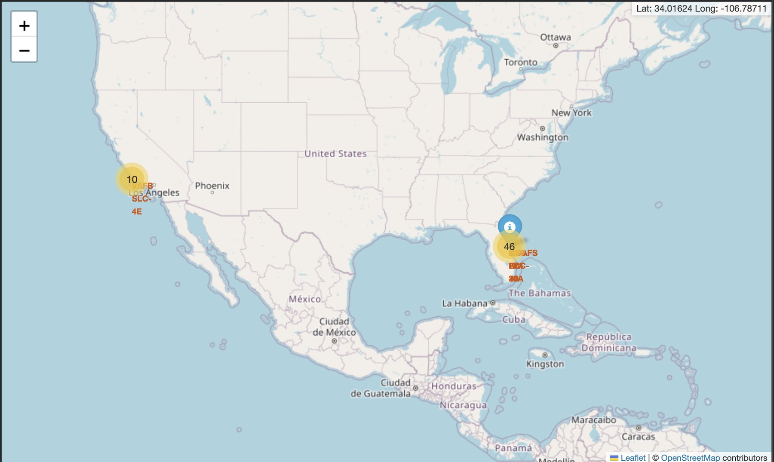
IBM Data Science Capstone | SpaceX Falcon 9 Landing Prediction
Folium Results: Proximity Analysis
The proximity maps show why launch sites are operationally positioned near open water while still remaining close enough to transportation and support infrastructure.
Cooper Robinson | GitHub: https://github.com/cooper-710/Coursera-Capstone

Slide 18
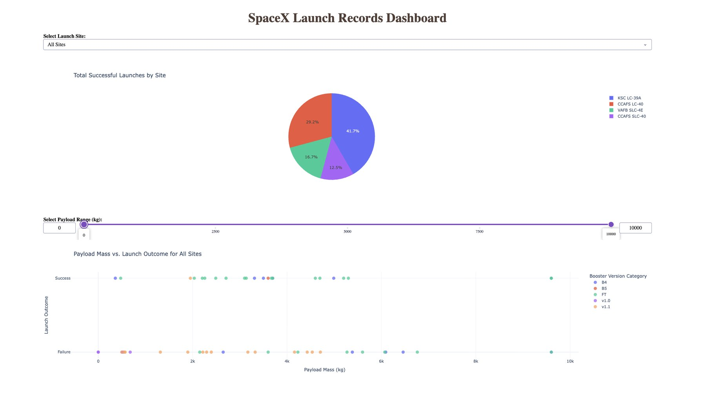
IBM Data Science Capstone | SpaceX Falcon 9 Landing Prediction
Plotly Dash Dashboard Methodology
Built a local Dash app using pandas, Plotly, and Dash callbacks.
Added a launch site dropdown to switch between all sites and individual launch sites.
Added a payload range slider to filter launches by payload mass.
Updated pie and scatter charts interactively based on dropdown and slider inputs.
The dashboard turns static EDA into an interactive tool for exploring success rate by site and payload range.
Cooper Robinson | GitHub: https://github.com/cooper-710/Coursera-Capstone

Slide 19
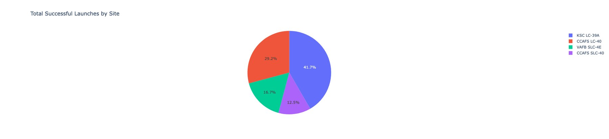
IBM Data Science Capstone | SpaceX Falcon 9 Landing Prediction
Dash Results: Successful Launches by Site
The all-sites pie chart compares successful launches across major launch sites.
KSC LC-39A accounts for the largest share of successful launches in the dashboard output.
This output directly supports the project requirement for Plotly Dash dashboard results.
Dashboard answer: KSC LC-39A appears as the strongest successful-launch contributor in the filtered dashboard view.
Cooper Robinson | GitHub: https://github.com/cooper-710/Coursera-Capstone

Slide 20
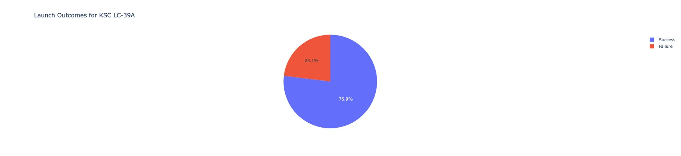
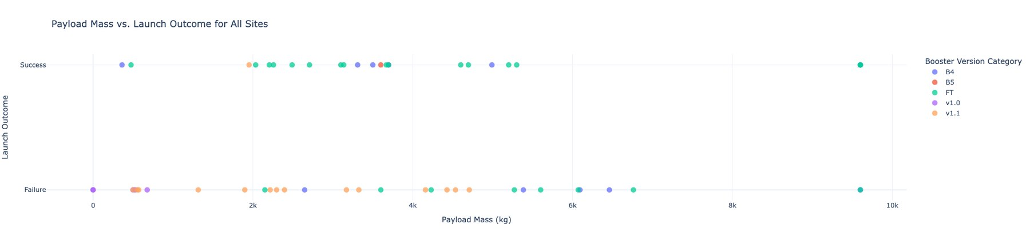
IBM Data Science Capstone | SpaceX Falcon 9 Landing Prediction
Dash Results: Site Selection and Payload Scatter
The selected-site pie chart compares success versus failure for one launch site.
The payload scatter shows launch outcome by payload mass and booster version category.
The scatter plot shows successful landings across a wide payload range, but failures remain present, especially in earlier booster categories.
Cooper Robinson | GitHub: https://github.com/cooper-710/Coursera-Capstone

Slide 21
IBM Data Science Capstone | SpaceX Falcon 9 Landing Prediction
Predictive Analysis Methodology
Created feature matrix X and target vector Y from the cleaned launch dataset.
Standardized numerical and encoded categorical features before model training.
Split data into training and test sets.
Used GridSearchCV to tune hyperparameters for Logistic Regression, SVM, Decision Tree, and KNN.
Evaluated each model using test accuracy and confusion matrix output.
Model | Role in comparison
Logistic Regression | Simple linear baseline
SVM | Margin-based classifier
Decision Tree | Interpretable nonlinear model
KNN | Instance-based classifier
The modeling section focused on comparing several classification approaches rather than relying on one model by default.
Cooper Robinson | GitHub: https://github.com/cooper-710/Coursera-Capstone

Slide 22
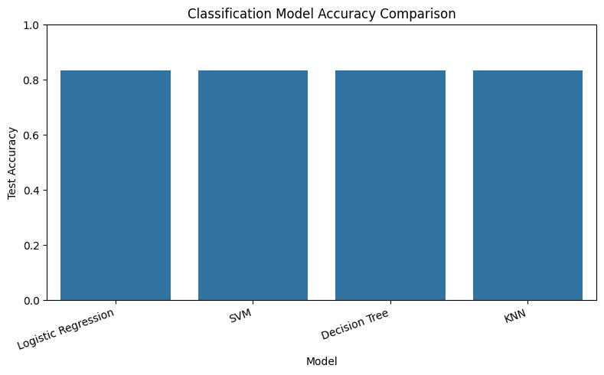
IBM Data Science Capstone | SpaceX Falcon 9 Landing Prediction
Predictive Analysis Results: Model Accuracy
All four models reached about 83.3% test accuracy.
Because accuracy was tied, the simplest model, Logistic Regression, is a practical final model choice.
The similar performance suggests that the dataset is small enough that model choice is less important than feature quality and class balance.
Cooper Robinson | GitHub: https://github.com/cooper-710/Coursera-Capstone

Slide 23
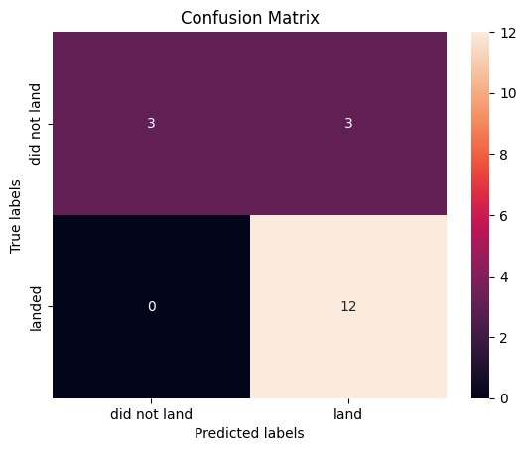
IBM Data Science Capstone | SpaceX Falcon 9 Landing Prediction
Predictive Analysis Results: Confusion Matrix
Metric | Value
Correct predictions | 15 / 18
Test accuracy | 83.3%
Correct landed predictions | 12
Correct did-not-land predictions | 3
False positives | 3
False negatives | 0
Interpretation: the model predicts successful landings well, but it is weaker at catching failed landing cases.
Cooper Robinson | GitHub: https://github.com/cooper-710/Coursera-Capstone

Slide 24
IBM Data Science Capstone | SpaceX Falcon 9 Landing Prediction
Key Findings
1
Launch maturity matters
2
Launch context matters
Yearly trend and flight number analysis show success improved over time.
Site, orbit type, and payload mass produce different success patterns.
3
Interactive tools improve analysis
4
Prediction is useful but imperfect
Folium and Dash make site geography and payload filters easier to explore.
Models reached 83.3% accuracy, but failures are harder to classify.
Most important insight: the landing problem is not random. Operational experience and launch configuration provide meaningful predictive signal.
Cooper Robinson | GitHub: https://github.com/cooper-710/Coursera-Capstone

Slide 25
IBM Data Science Capstone | SpaceX Falcon 9 Landing Prediction
Innovative Insights Beyond the Template
Failure risk is asymmetric: the final classifier made no false negative landing predictions, but it did label some failed landings as successful. That matters because false confidence is more costly than conservative prediction.
Payload mass should not be interpreted in isolation. It needs to be read with booster version and launch site because different mission profiles create different risk patterns.
Launch site comparisons become clearer when static charts are paired with geographic context. Folium adds physical intuition that a regular chart cannot show.
A future version could turn the Dash app into a mission planning tool with probability output, confidence flags, and model explanations for each prediction.
Creative enhancement used in this report: the project outputs were organized as a complete analysis package with GitHub, notebooks, map screenshots, dashboard screenshots, and model result visuals.
Cooper Robinson | GitHub: https://github.com/cooper-710/Coursera-Capstone

Slide 26
IBM Data Science Capstone | SpaceX Falcon 9 Landing Prediction
Conclusion
The SpaceX Falcon 9 landing project showed how a full data science workflow can move from raw data to useful operational insight.
Data collection and wrangling produced a usable supervised learning dataset.
EDA and SQL identified meaningful patterns in site, orbit, payload, booster, and yearly recovery trends.
Folium and Dash added interactivity and made the analysis easier to explore.
Machine learning models predicted landing outcomes with about 83.3% test accuracy.
The main limitation is failure detection, which should be improved with more launch records, richer booster features, and probability calibration.
Final recommendation: use the model as a decision-support tool, not a standalone decision maker. It is strong enough for pattern detection, but not enough for high-risk launch decisions without additional validation.
Cooper Robinson | GitHub: https://github.com/cooper-710/Coursera-Capstone

Slide 27
IBM Data Science Capstone | SpaceX Falcon 9 Landing Prediction
Final Deliverable Checklist
Required component | Included
GitHub repository link | Yes
PDF presentation report | Yes
Executive summary and introduction | Yes
Data collection and wrangling methodology | Yes
EDA and SQL results | Yes
Folium map results | Yes
Plotly Dash dashboard results | Yes
Predictive classification results | Yes
Conclusion | Yes
Creativity and innovative insights | Yes
Submission file name: Data Science Capstone Project Report.pdf
Cooper Robinson | GitHub: https://github.com/cooper-710/Coursera-Capstone

Slide 28
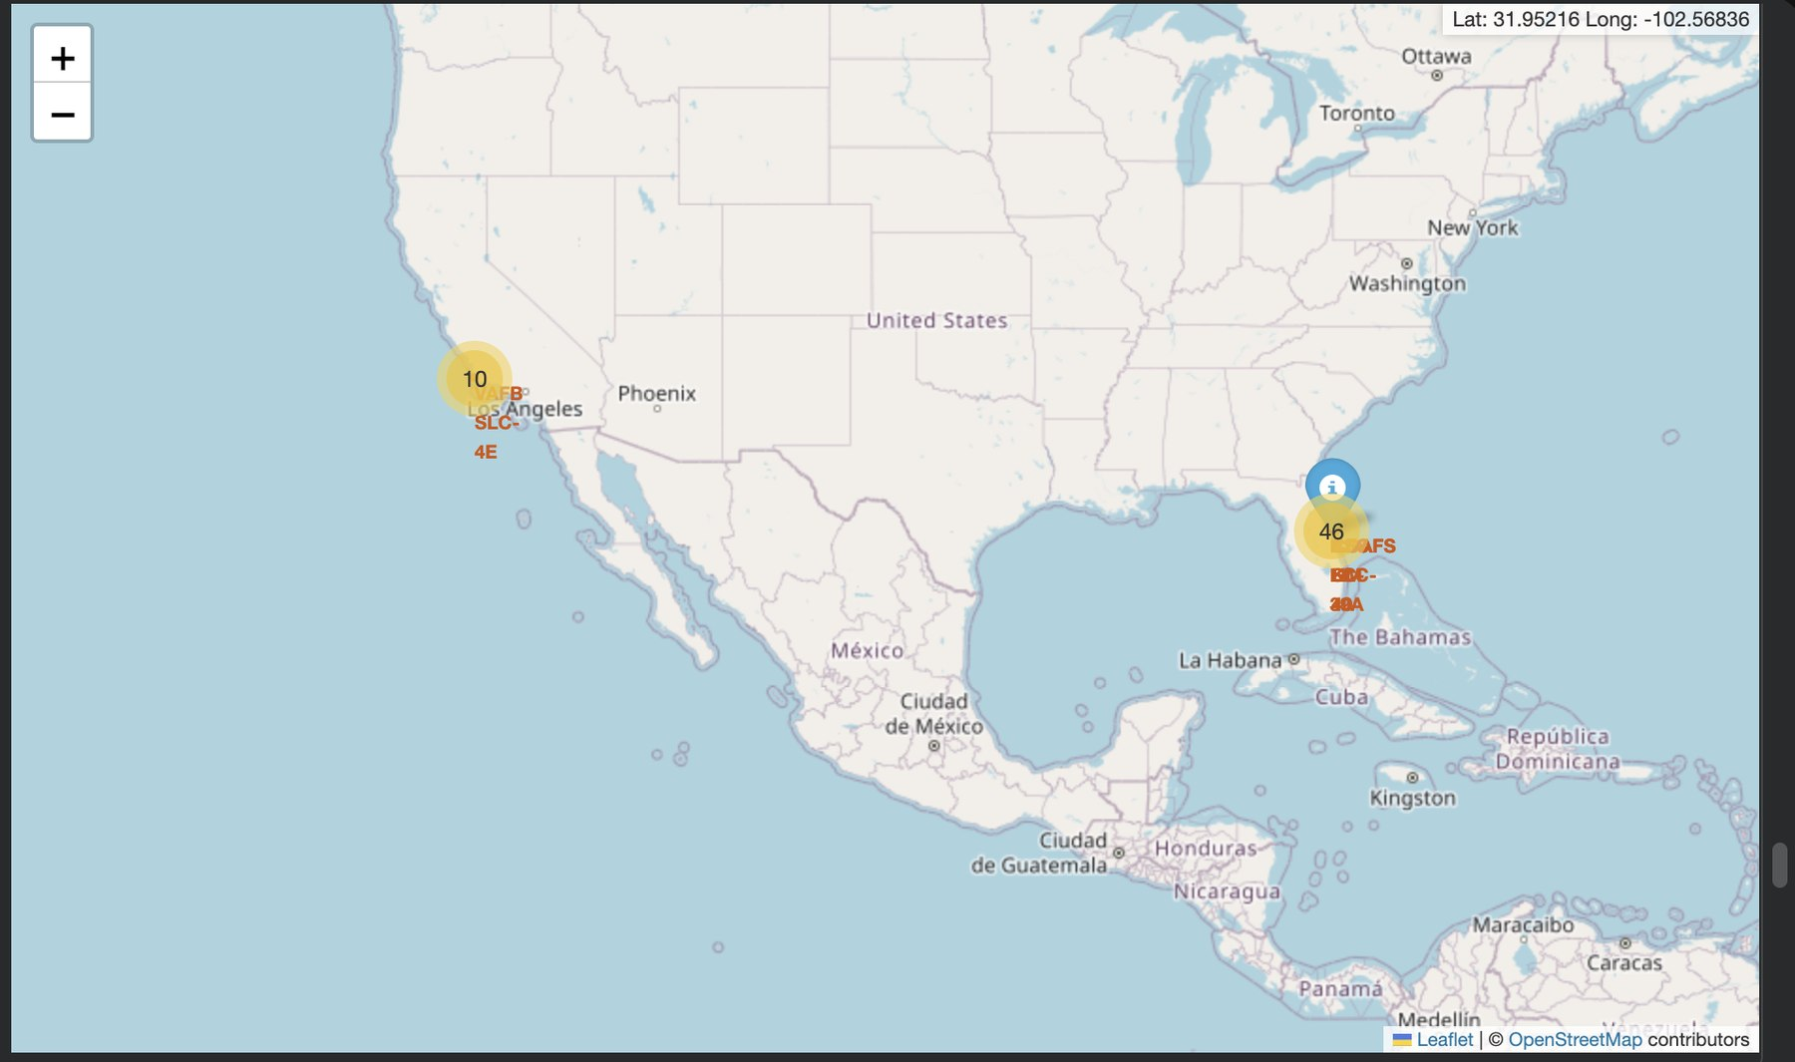
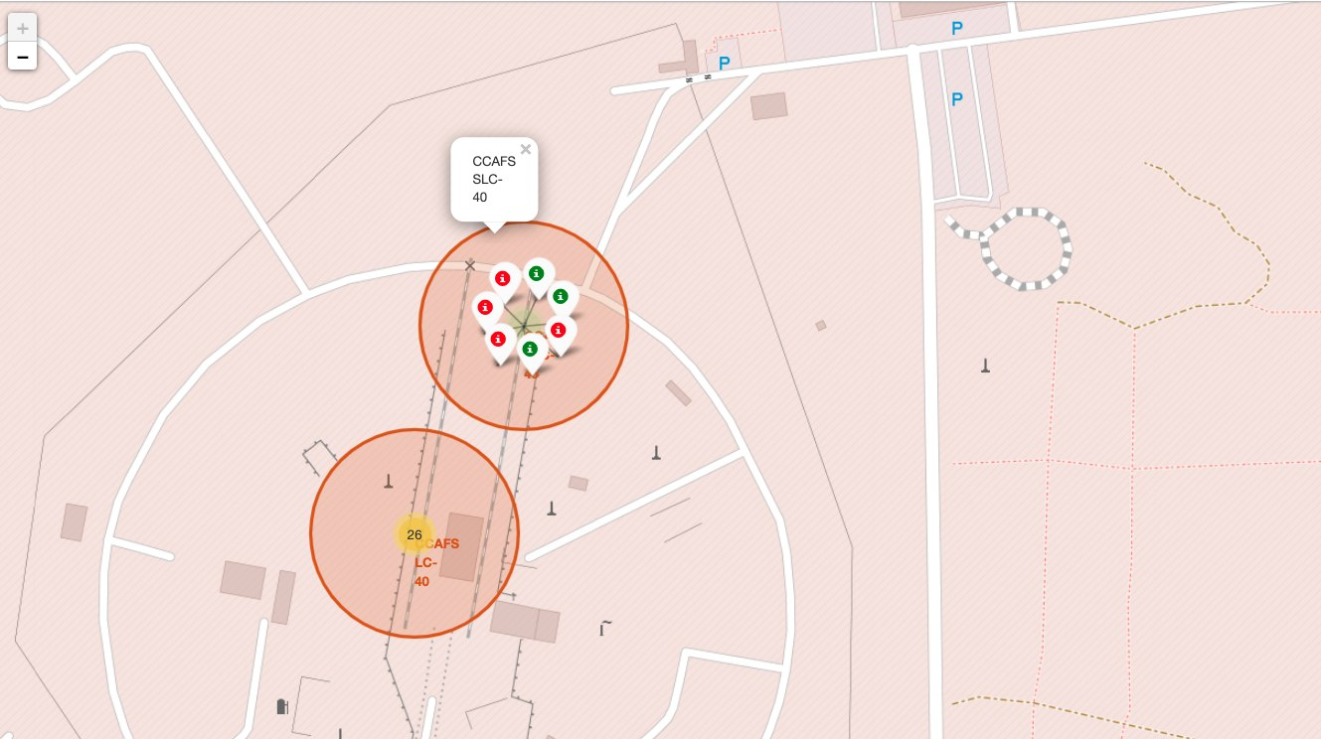
IBM Data Science Capstone | SpaceX Falcon 9 Landing Prediction
Appendix: Additional Visual Outputs
Additional screenshots and notebook outputs are available in the GitHub images and notebooks folders.
Cooper Robinson | GitHub: https://github.com/cooper-710/Coursera-Capstone

Slide 29
IBM Data Science Capstone | SpaceX Falcon 9 Landing Prediction
Repository and Submission Reference
GitHub repository
https://github.com/cooper-710/Coursera-Capstone
Repository includes all completed notebooks, dashboard code, screenshots, README, and requirements file.
The PDF version of this deck is the file submitted for the final assignment.
The analysis was completed using the IBM Data Science Capstone SpaceX Falcon 9 project workflow.
File to submit: Data Science Capstone Project Report.pdf
Cooper Robinson | GitHub: https://github.com/cooper-710/Coursera-Capstone

